Slide 1

SYLLABUS
UNIT III ENUMERATION AND VULNERABILITY ANALYSIS 6
Enumeration Concepts - NetBIOS Enumeration – SNMP, LDAP, NTP, SMTP and DNS Enumeration - Vulnerability Assessment Concepts - Desktop and Server OS Vulnerabilities -Windows OS Vulnerabilities

Slide 2
Enumeration:
Enumeration is the process of establishing an active connection to the target host, where sensitive information is collected and assessed
Windows enumeration, NetBIOS, LDAP,SNMP are some of the types of enumeration

Slide 3
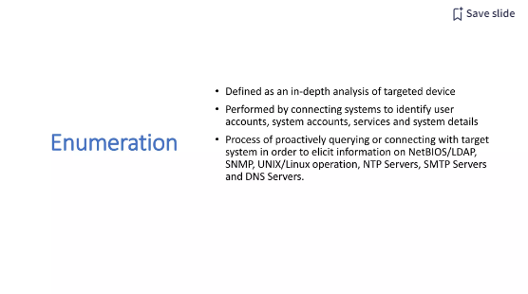
3.1 Enumeration

Slide 4
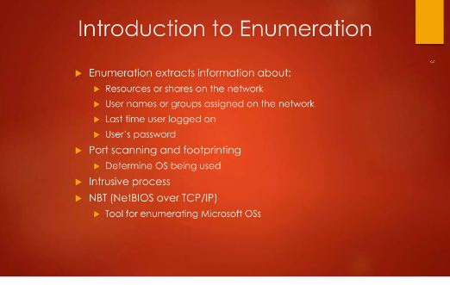
3.1 Enumeration
CW3551/DIS/III AI&DS/V SEM/KG-KiTE

Slide 5
3.1 Enumeration
NetBIOS is a Windows programming interface that allows computers to communicate across a local area network (LAN).
Most Windows OSs use NetBIOS to share files and printers.
NetBIOS listens on UDP ports 137 (NetBIOS Name service) and 138 (NetBIOS Datagram service) and TCP port 139 (NetBIOS Session service).
File and printer sharing in Windows also requires an upper-level service called Server Message Block (SMB), which runs on top of NetBIOS.
CW3551/DIS/III AI&DS/V SEM/KG-KiTE

Slide 6
3.1 Enumeration
The computer names you assign to Windows systems are called NetBIOS names and have a limit of 16 characters;
the last character is reserved for a hexadecimal number (00 to FF) that identifies the service running on the computer.
Therefore, you can use only 15 characters for a computer name, and NetBIOS adds the last character automatically to identify the service that has registered with the OS.
For example, if a computer named SALESREP is running the Server service, the OS stores this information in a NetBIOS table.
A NetBIOS name must be unique on a network.
CW3551/DIS/III AI&DS/V SEM/KG-KiTE

Slide 7
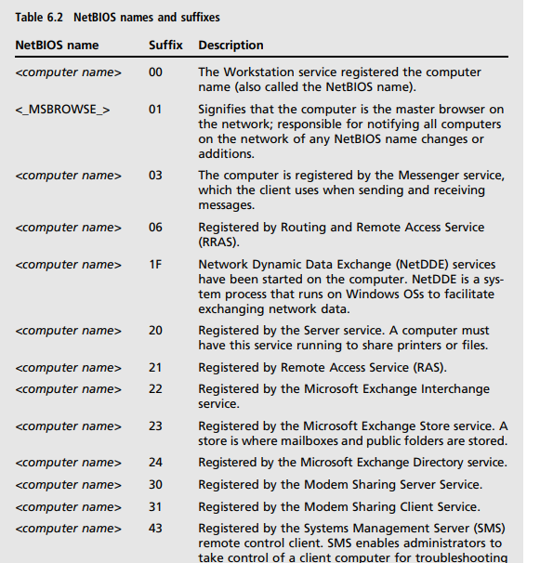
3.1 Enumeration
CW3551/DIS/III AI&DS/V SEM/KG-KiTE

Slide 8
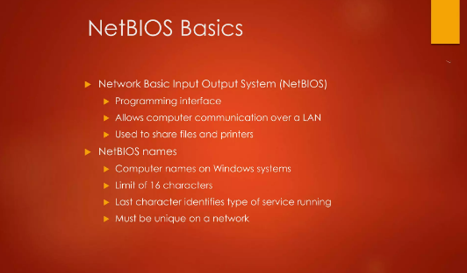
3.1 Enumeration
CW3551/DIS/III AI&DS/V SEM/KG-KiTE

Slide 9
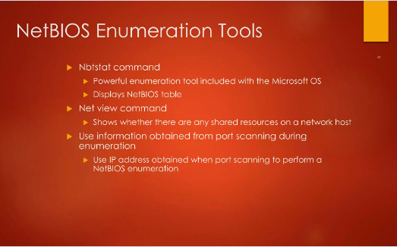
3.1 Enumeration
CW3551/DIS/III AI&DS/V SEM/KG-KiTE

Slide 10
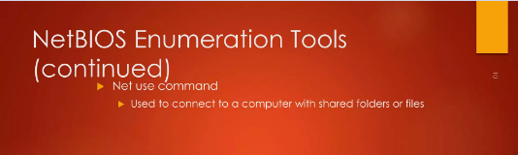
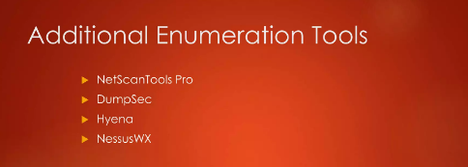
3.1 Enumeration
CW3551/DIS/III AI&DS/V SEM/KG-KiTE

Slide 11
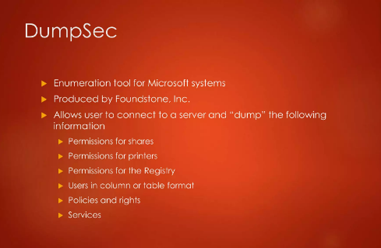
3.1 Enumeration
CW3551/DIS/III AI&DS/V SEM/KG-KiTE

Slide 12
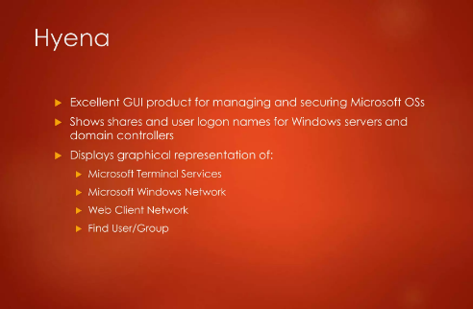
3.1 Enumeration
CW3551/DIS/III AI&DS/V SEM/KG-KiTE

Slide 13
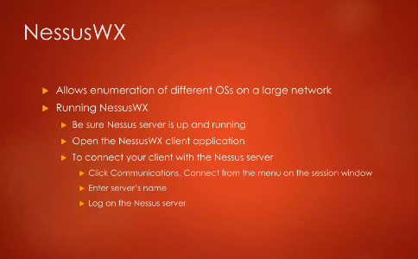
3.1 Enumeration
CW3551/DIS/III AI&DS/V SEM/KG-KiTE

Slide 14
3.1 Enumeration
Types Of Enumeration:
NetBIOS(Network Basic Input Output System) Enumeration:
• NetBIOS allows applications on different computers to communicate over LANs
• Currently uses TCP/IP
• Gives each computer a NetBIOS name along with normal IP address
NBT is a protocol that allows legacy applications that rely on NetBIOS to be used on modern TCP/IP networks
• NBT implements a Name Service that records all name registrations
NetBIOS provides three basic services:
• NAME SERVICE • The name service provides name registration and resolution for clients
• SESSION SERVICE • The session service provides connection-oriented communication
• DATAGRAM SERVICE • The datagram service provides for a connectionless communication
CW3551/DIS/III AI&DS/V SEM/KG-KiTE

Slide 15
3.1 Enumeration
LDAP Enumeration:
Lightweight Directory Access Protocol is an Internet Protocol for getting to dispersed registry administrations.
Registry administrations may give any coordinated arrangement of records, regularly in a hierarchical and sensible structure, for example, a corporate email index.
A customer starts an LDAP meeting by associating with a Directory System Agent on TCP port 389 and afterward sends an activity solicitation to the DSA.
Data is sent between the customer and the worker utilizing Basic Encoding Rules.
Programmer inquiries LDAP administration to assemble information such as substantial usernames, addresses, division subtleties, and so on that can be additionally used to perform assaults.
CW3551/DIS/III AI&DS/V SEM/KG-KiTE

Slide 16
3.1 Enumeration
LDAP Enumeration:
Lightweight Directory Access Protocol is an Internet Protocol for getting to dispersed registry administrations.
Registry administrations may give any coordinated arrangement of records, regularly in a hierarchical and sensible structure, for example, a corporate email index.
A customer starts an LDAP meeting by associating with a Directory System Agent on TCP port 389 and afterward sends an activity solicitation to the DSA.
Data is sent between the customer and the worker utilizing Basic Encoding Rules.
Programmer inquiries LDAP administration to assemble information such as substantial usernames, addresses, division subtleties, and so on that can be additionally used to perform assaults.
Examples of these kinds of tools include LDAP Admin Tool, Active Directory Explorer, LDAP Admin, etc.
CW3551/DIS/III AI&DS/V SEM/KG-KiTE

Slide 17
3.1 Enumeration
DNS Enumeration using Zone Transfer:
It is a cycle for finding the DNS worker and the records of an objective organization.
A hacker can accumulate significant organization data, for example, DNS worker names, hostname, machine names, usernames, IPs, and so forth of the objectives.
In DNS Zone Transfer enumeration, a hacker tries to retrieve a copy of the entire zone file for a domain from the DNS server.
In order to execute a zone transfer, the hacker sends a zone transfer request to the DNS server pretending to be a client; the DNS then sends a portion of its database as a zone to you. This zone may contain a ton of data about the DNS zone organization.
CW3551/DIS/III AI&DS/V SEM/KG-KiTE

